Slide 1
CITY OF DALLAS OPERATING BUDGET
FINAL PROJECT - DATA WIZARDS

Slide 2

STEPS INCLUDED IN PROJECT
Introduction
Problem Statement
Business Understanding
Data Understanding
Data Preparation
Queries and Visualization

Slide 3

INTRODUCTION
Optimizing City Finances: A Deep Dive into Dallas Operating Budget
Welcome to an insightful journey into the heart of Dallas's financial landscape. Today, we embark on a data-driven exploration of the City of Dallas Operating Budget, seeking to unlock valuable insights that will empower city administrators in optimizing budget allocations and enhancing performance evaluation.
Objectives:
Uncover trends in fund utilization across service categories.
Identify departments with consistent budget variances.
Define key performance indicators for optimal resource utilization.

Slide 4
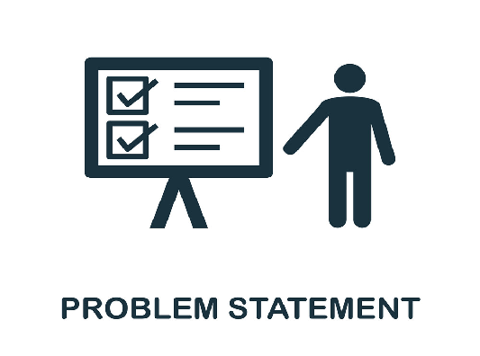
PROBLEM STATEMENT
Challenges in City Budget Management
City administrators aim to optimize budget allocations across various departments to ensure effective service delivery and financial sustainability. However, managing diverse funds, departments, and service categories can be challenging. The city administrator seeks insights and recommendations to enhance budget planning, resource utilization, and performance evaluation based on historical financial data.

Slide 5
BUSINESS UNDERSTANDING
Understanding City Budget Needs
Optimize Budget Allocations:
Identify trends in fund utilization and service categories over the years.
Determine areas with consistent underutilization or overspending.
Performance Evaluation:
Assess the impact of budget allocations on the performance of each department.
Identify key performance indicators for effective monitoring and evaluation.

Slide 6
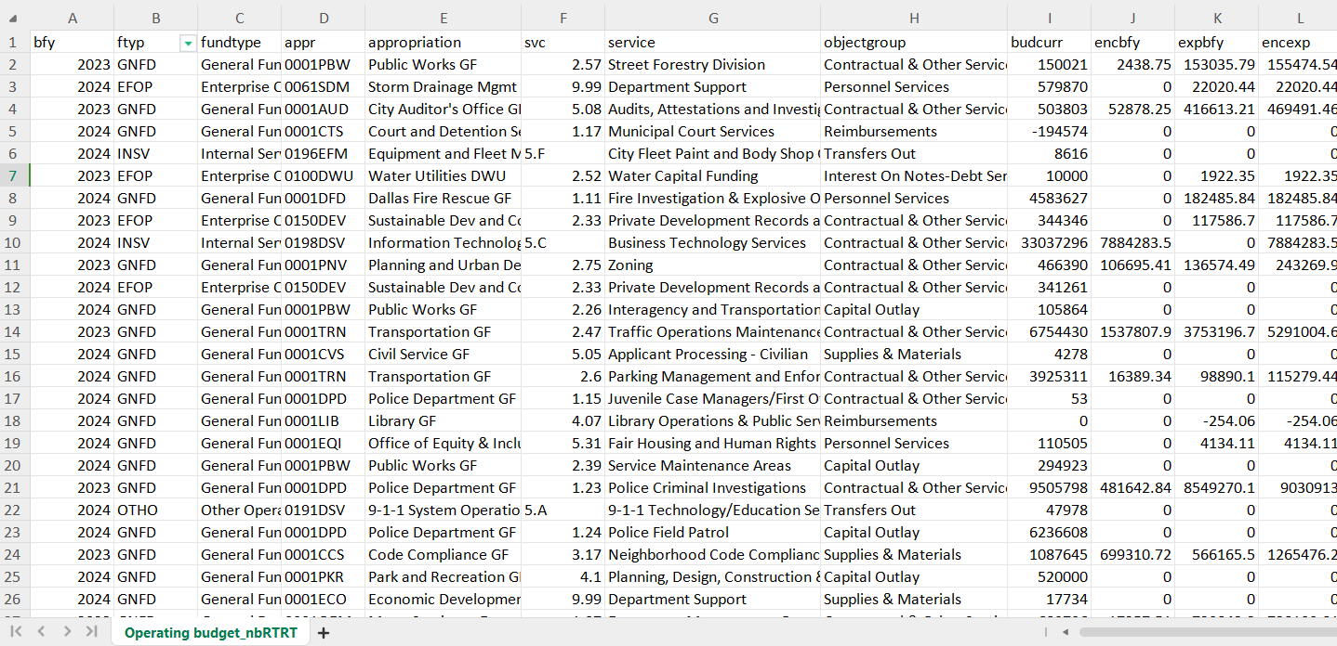
DATA UNDERSTANDING City of Dallas Operating Budget Dataset
Originl CSV taken from https://www.dallasopendata.com/Economy/Operating-Budget/e2fs-y4nb
This data set contains City’s operating budget at different levels including department and service.

Slide 7
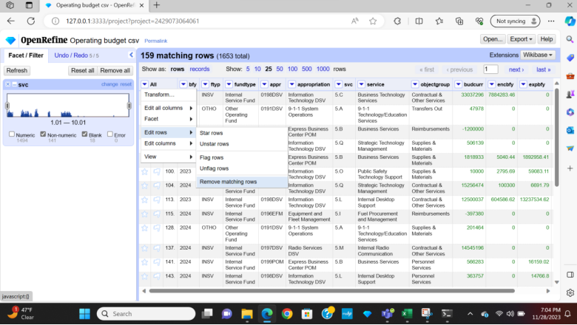
DATA PREPARATION
The data was prepared for further analysis using Open Refine.
Text facets were utilised to check for typos/misspellings in the text entries. There were no errors.
The common transforms function in OpenRefine was used to "text to number" convert the SVC, Current Budget, Encumbrance and expenses columns.

Slide 8
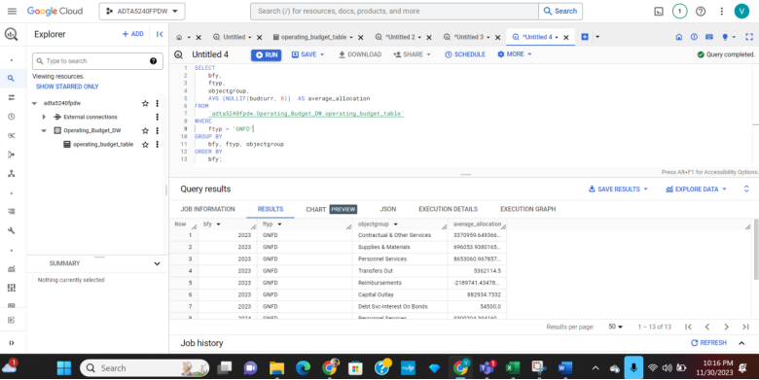
Executing Queries in BigQuery
Trends in fund utilization for the General Fund (GNFD) across different service categories over the years.
The query provides the average current budget for each service category within the General Fund (GNFD) over the years.
City administrators can use this information to identify trends and patterns in fund utilization across different services.

Slide 9
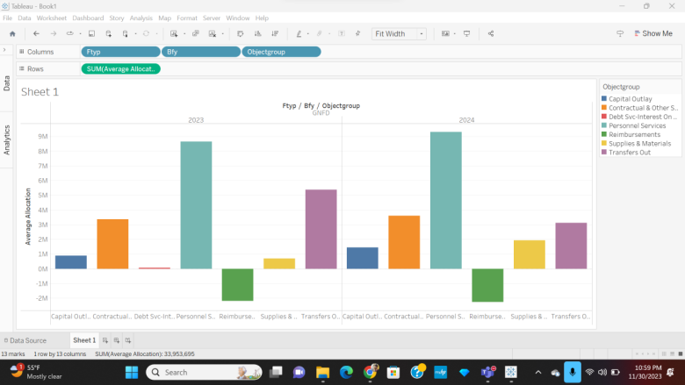
DATA VISUALIZATION

Slide 10
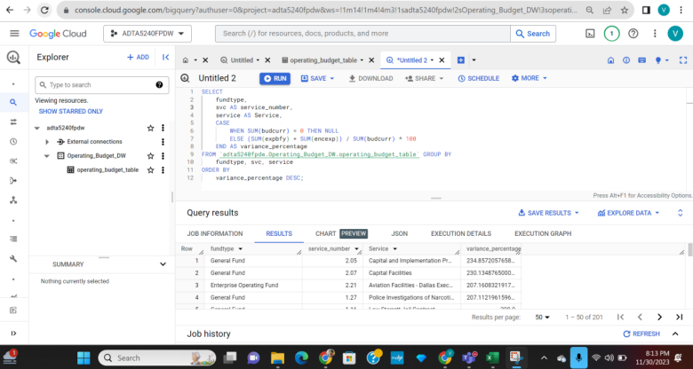
Executing Queries in BigQuery
Departments that consistently overspent or underspent their allocated budgets, and the overall variance percentage for each department.
The query calculates the variance percentage between the allocated budget and actual expenditures for each department across all fund types.
City administrators can use this information to identify departments with consistent overspending or underspending and take corrective actions.

Slide 11
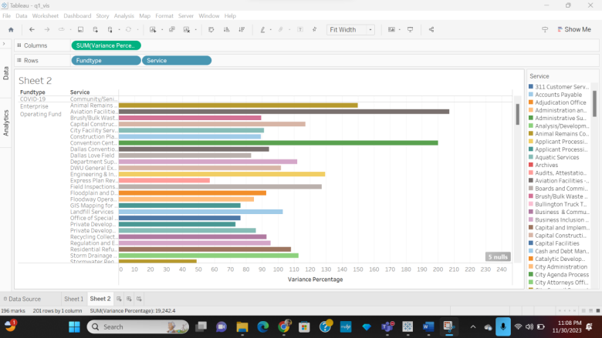
DATA VISUALIZATION

Slide 12
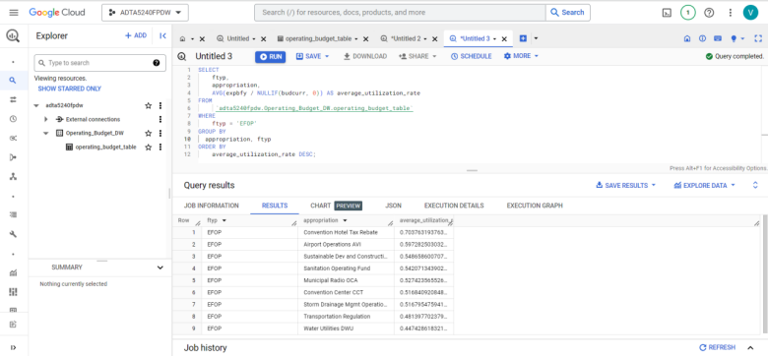
Executing Queries in BigQuery
Key Performance Indicators (KPIs) for monitoring the performance of the Enterprise Operating Fund (EFOP) departments in terms of budget utilization
The query provides key performance indicators, including total budget, total expenditure, and average utilization rate for each department within the Enterprise Operating Fund (EFOP).
City administrators can use this information to evaluate the efficiency of budget utilization and identify departments with potential optimization opportunities.

Slide 13
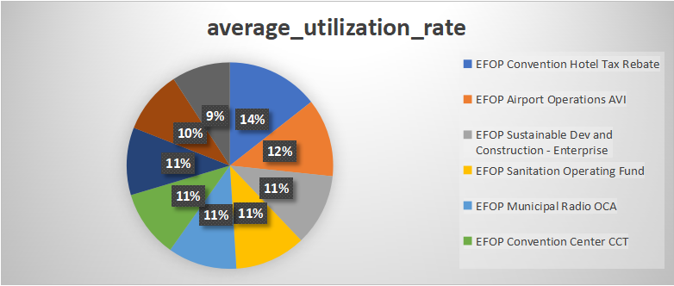
DATA VISUALIZATION

Slide 14



TOOLS USED

Slide 15
TEAM & ROLES
ARCHANA BATHULA
NIKHILA PINNAPUREDDY
VENKATA SAI MANOJ MADIRAJU
VISHWA TEJ REDDY CHITLA
NEERAJ CHILAMKURTHI
- QUERYING DATA, VISUALIZE COMPOSER
- DATA ANALYZING, PRESENTATION
- VISUALIZE COMPOSER, DATA CLEANING
- QUERYING DATA, DOCUMENTATION
- RESULTS COMPOSER, DOCUMENTATION

Slide 16
THANK YOU

